Slide 1
DATABASE MANAGEMENT SYSTEMS
18CS53

Slide 2
Classroom Courtesy
Please have your phones on silent during class
Please don’t distract yourself or others by playing with your laptop / phones

Slide 3
Text Books
Reading will fill in the details.
– Fundamentals of Database Systems, Ramez Elmasri and Shamkant B. Navathe, 7th Edition, 2017, Pearson.
– Database management systems, Ramakrishnan, and Gehrke, 3rd Edition, 2014, McGraw Hill.

Slide 4
What is a database?
What is a database system?
Why this course?

Slide 5
What is a Database?
• Database:
– A collection of related data.
• Data:
– Known facts that can be recorded and have an implicit meaning.
• Mini-world:
– Some part of the real world about which data is stored in a database.

Slide 6
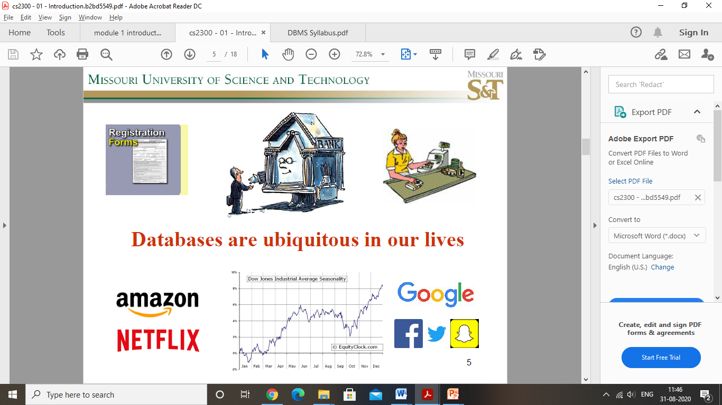

Slide 7
What is a Database System?
Database Management System (DBMS)
– A software package/ system to facilitate the creation and maintenance of a computerized database
– Data Definitions (data types, structures, constraints)
– Data Constructions (storing data on some storage medium)
– Data Manipulations (querying, update, report generation)
• Database System
– The DBMS software together with the data itself.
Sometimes, the applications are also included.

Slide 8
Course Goal
Understand the foundations on which today’s work is built
– Existing database systems
– Abstract thinking about real world modelling with
Databases
– How data is stored on commercial storage devices
– Efficient querying and manipulating data
Build your own database systems by the end of the
semester
– Complete a course project

Slide 9
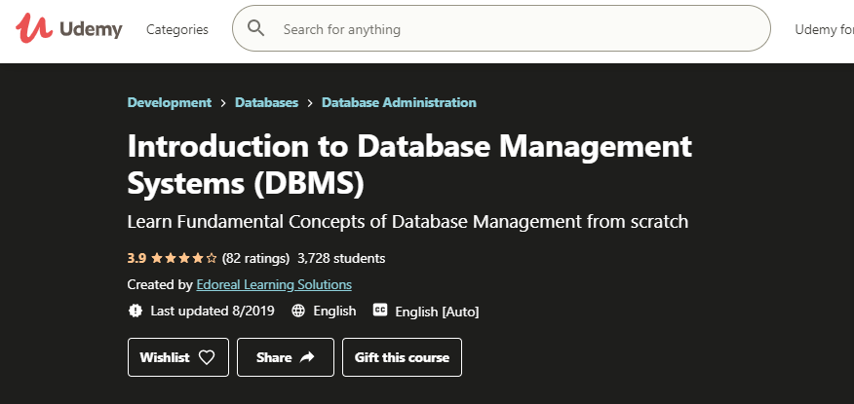
https://www.youtube.com/watch?v=fSWAkJz_huQ
Udemy Course

Slide 10
Module 1
Introduction to databases
  Chapter 1: Databases and database users
  Introduction, Characteristics of the database approach, Advantages of using the DBMS approach, A brief history of database applications
  Chapter 2: Database System Concepts and Architecture
  Data models, Schemas and instances, Three schema architecture and data independence, Database languages and interfaces, Database system environment
  Chapter 3: Data Modeling Using Entity-Relationship (ER) Model
Entity types, Entity sets, attributes, roles, and structural constraints, Weak entity types, ER diagrams, examples
  Chapter 4: The Enhanced Entity-Relationship (EER) Model
  Specialization and Generalization

Slide 11
CHAPTER 1
Databases and Database Users

Slide 12
Types of Databases and Database Users
Traditional Applications:
  Numeric and Textual Databases
More Recent Applications:
  Bigdata storage systems or NOSQL systems – social media applications
  Multimedia Databases
  Geographic Information Systems (GIS) - store and analyze maps, weather data, and satellite images
  Data Warehouses, Online analytical processing (OLAP) – extract business information
  Real-time and Active Databases - industrial and manufacturing processes
  Database search techniques - WWW
  Many other applications

Slide 13
Properties of database
Mini world or University of Discourse (UoD)
Collection of data with some inherent meaning
Designed, built and populated with data for a specific purpose

Slide 14
Example of a Database
(with a Conceptual Data Model)
Mini-world for the example:
  Part of a UNIVERSITY environment.
Some mini-world entities:
  STUDENTs
  COURSEs
  SECTIONs (of COURSEs)
  (academic) DEPARTMENTs
  INSTRUCTORs

Slide 15
Example of a Database
(with a Conceptual Data Model)
Some mini-world relationships:
  SECTIONs are of specific COURSEs
  STUDENTs take SECTIONs
  COURSEs have prerequisite COURSEs
  INSTRUCTORs teach SECTIONs
  COURSEs are offered by DEPARTMENTs
  STUDENTs major in DEPARTMENTs
Note: The above entities and relationships are typically expressed in a conceptual data model, such as the ENTITY-RELATIONSHIP data model

Slide 16

Example of a simple database

Slide 17
Characteristics of the Database Approach
Self-describing nature of a database system:
  A DBMS catalog stores the description of a particular database (e.g. data structures, types, and constraints)
  The description is called meta-data.
  This allows the DBMS software to work with different database applications.
Insulation between programs and data:
  Called program-data independence.
  Allows changing data structures and storage organization without having to change the DBMS access programs.

Slide 18
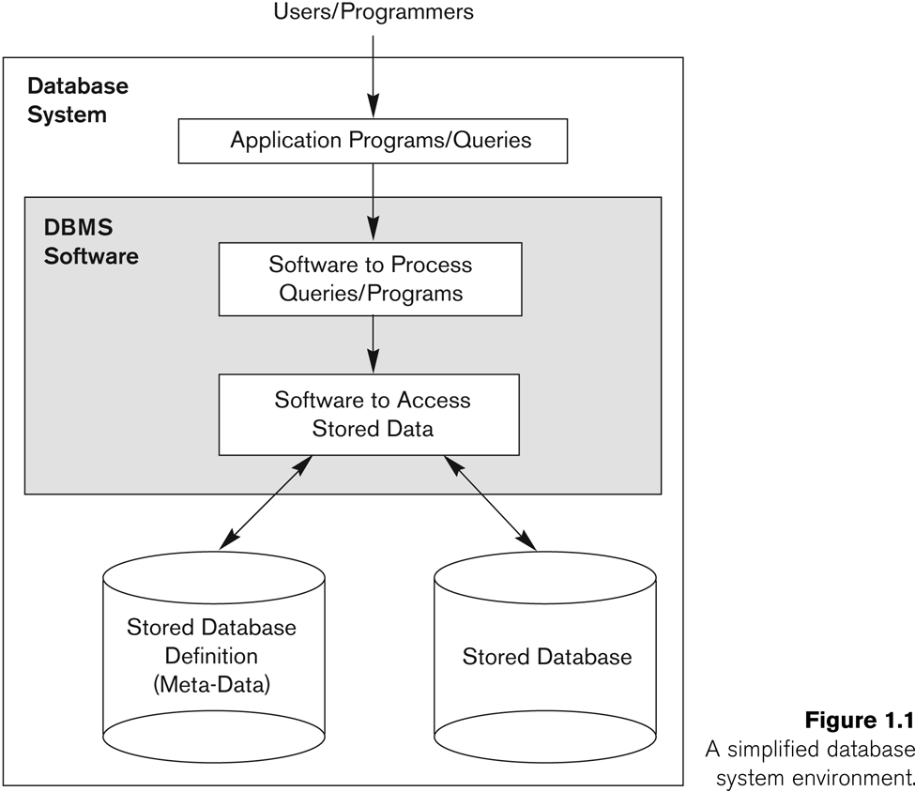
Simplified database system environment

Slide 19
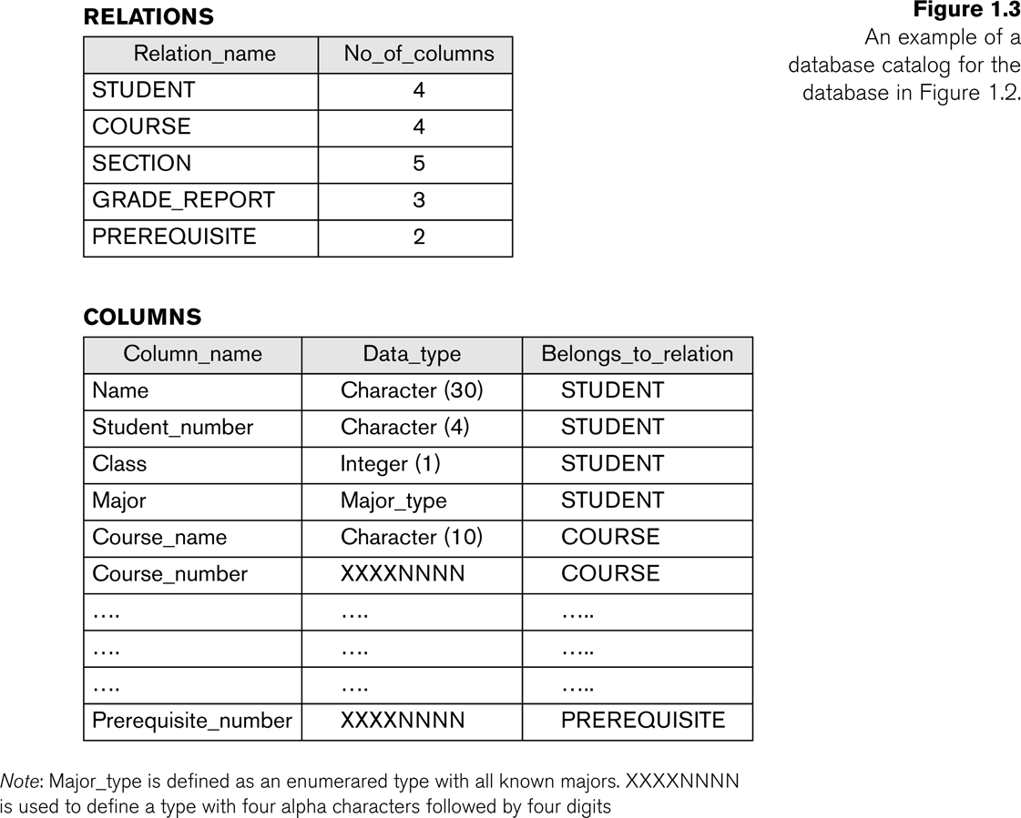
Example of a simplified database catalog

Slide 20
Main Characteristics of the Database Approach (continued)
Data Abstraction:
  A data model is used to hide storage details and present the users with a conceptual view of the database.
  Program-data independence and program-operation independence.
Support of multiple views of the data:
  Each user may see a different view of the database, which describes only the data of interest to that user.

Slide 21
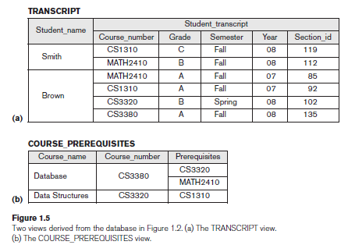
Multiple views of the data

Slide 22
Main Characteristics of the Database Approach (continued)
Sharing of data and multi-user transaction processing:
  Allowing a set of concurrent users to retrieve from and to update the database.
  Concurrency control within the DBMS guarantees that each transaction is correctly executed or aborted.
  Recovery subsystem ensures each completed transaction has its effect permanently recorded in the database.
  OLTP (Online Transaction Processing) is a major part of database applications. This allows hundreds of concurrent transactions to execute per second.

Slide 23
Advantages of Using the Database Approach
Controlling redundancy in data storage and in development and maintenance efforts
  Sharing of data among multiple users
  Normalization, denormalization
Restricting unauthorized access to data
Providing persistent storage for program Objects
Providing Storage Structures for efficient Query Processing
  Indexes
  Buffering or caching
  Query processing and optimization module

Slide 24
Advantages of Using the Database Approach (continued)
Providing backup and recovery services
Providing multiple interfaces to different classes of users
  GUIs
Representing complex relationships among data
Enforcing integrity constraints on the database
  Referential integrity constraint
  Key or unique constraint
Permitting inferencing and actions using rules and triggers
  Deductive database systems
  Stored procedures
  Triggers

Slide 25
Additional Implications of Using the Database Approach
Potential for enforcing standards:
  This is very crucial for the success of database applications in large organizations. Standards refer to data item names, display formats, screens, report structures, meta-data (description of data), Web page layouts, etc.
Reduced application development time:
  Incremental time to add each new application is reduced.

Slide 26
Additional Implications of Using the Database Approach (continued)
Flexibility to change data structures:
  Database structure may evolve as new requirements are defined.
Availability of current information:
  Extremely important for on-line transaction systems such as airline, hotel, car reservations.
Economies of scale:
  Wasteful overlap of resources and personnel can be avoided by consolidating data and applications across departments.

Slide 27
Historical Development of Database Technology
Early Database Applications:
  The Hierarchical and Network Models were introduced in mid 1960s and dominated during the seventies.
  A bulk of the worldwide database processing still occurs using these models, particularly, the hierarchical model.
Relational Model based Systems:
  Relational model was originally introduced in 1970, was heavily researched and experimented within IBM Research and several universities.
  Relational DBMS (RDBMS) Products emerged in the early 1980s.

Slide 28
Historical Development of Database Technology (continued)
Object-oriented and emerging applications:
  Object-Oriented Database Management Systems (OODBMSs) were introduced in late 1980s and early 1990s to cater to the need of complex data processing in CAD and other applications
  Many relational DBMSs have incorporated object database concepts, leading to a new category called object-relational DBMSs (ORDBMSs)
  Extended relational systems add further capabilities (e.g. for multimedia data, XML, and other data types)

Slide 29
Historical Development of Database Technology (continued)
Data on the Web and E-commerce Applications:
  Web contains data in HTML (Hypertext markup language) with links among pages
  This has given rise to a new set of applications and E-commerce is using new standards like XML (eXtended Markup Language)
  Script programming languages such as PHP and JavaScript allow generation of dynamic Web pages that are partially generated from a database
    Also allow database updates through Web pages
    Emergence of Big data storage systems and NOSQL systems

Slide 30
Extending Database Capabilities
New functionality is being added to DBMSs in the following areas:
  Scientific Applications
  Image Storage and Management
  Audio and Video Data Management
  Data Warehousing and Data Mining
  Spatial Data Management
  Time Series and Historical Data Management
The above gives rise to new research and development in incorporating new data types, complex data structures, new operations and storage and indexing schemes in database systems.

Slide 31
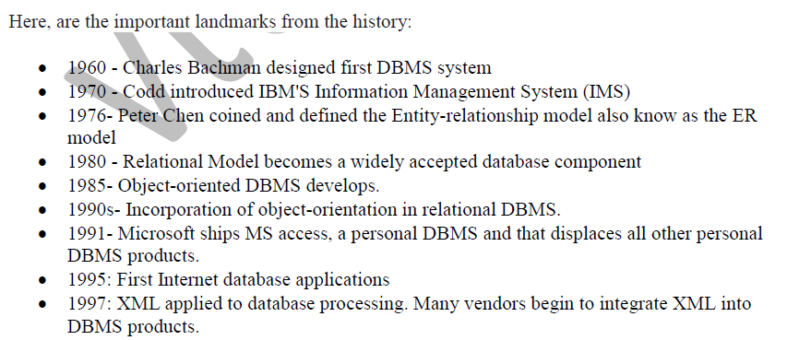
History of DBMS

Slide 32
CHAPTER 2
Database System Concepts and Architecture

Slide 33
Data Models
Data Model:
  A set of concepts to describe the structure of a database, the operations for manipulating these structures, and certain constraints that the database should obey
Data Model Structure and Constraints:
  Constructs are used to define the database structure
  Constructs typically include elements (and their data types) as well as groups of elements (e.g. entity, record, table), and relationships among such groups
  Constraints specify some restrictions on valid data; these constraints must be enforced at all times

Slide 34
Data Models (continued)
Data Model Operations:
  These operations are used for specifying database retrievals and updates by referring to the constructs of the data model.
  Operations on the data model may include basic model operations (e.g. generic insert, delete, update) and user-defined operations (e.g. compute_student_gpa, update_inventory)

Slide 35
Categories of Data Models
Conceptual (high-level, semantic) data models:
  Provide concepts that are close to the way many users perceive data.
    (Also called entity-based or object-based data models.)
Physical (low-level, internal) data models:
  Provide concepts that describe details of how data is stored in the computer. These are usually specified in an ad-hoc manner through DBMS design and administration manuals
Implementation (representational) data models:
  Provide concepts that fall between the above two, used by many commercial DBMS implementations (e.g. relational data models used in many commercial systems).

Slide 36
Categories of Data Models (continued)
Conceptual data model:
  entities, attributes, relationships
  ER model
  object data model
  Representational/implementation data model:
  Relational data model
  Network and hierarchical data model
  Record based data models
    Physical data model
  Access path – indexing or hashing
  Self describing data models:
  combines description of data with data values

Slide 37
Schemas, Instances, and Database state
Database Schema:
  The description of a database.
  Includes descriptions of the database structure, data types, and the constraints on the database.
Schema Diagram:
  An illustrative display of (most aspects of) a database schema.
Schema Construct:
  A component of the schema or an object within the schema, e.g., STUDENT, COURSE.

Slide 38
Schemas versus Instances
Database State:
  The actual data stored in a database at a particular moment in time. This includes the collection of all the data in the database.
  Also called database instance (or occurrence or snapshot).
    The term instance is also applied to individual database components, e.g. record instance, table instance, entity instance

Slide 39
Database Schema vs. Database State
Initial Database State:
  Refers to the database state when it is initially loaded into the system.
Valid State:
  A state that satisfies the structure and constraints of the database.

Slide 40
Database Schema vs. Database State (continued)
Distinction
  The database schema changes very infrequently.
  The database state changes every time the database is updated.
Schema is also called intension.
State is also called extension.

Slide 41
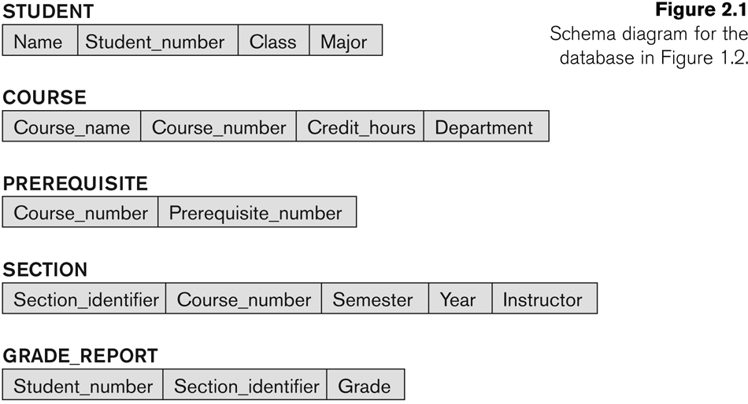
Example of a Database Schema

Slide 42
Example of a database state

Slide 43
Three-Schema Architecture
Proposed to support DBMS characteristics of:
  Program-data independence.
  Support of multiple views of the data.
Not explicitly used in commercial DBMS products, but has been useful in explaining database system organization

Slide 44
Three-Schema Architecture
Defines DBMS schemas at three levels:
  Internal schema at the internal level to describe physical storage structures and access paths (eg. indexes).
    Typically uses a physical data model.
  Conceptual schema at the conceptual level to describe the structure and constraints for the whole database for a community of users.
    Uses a conceptual or an implementation data model.
  External schemas at the external level to describe the various user views.
    Usually uses the same data model as the conceptual schema.

Slide 45
Three-Schema Architecture

Slide 46
Three-Schema Architecture
Mappings among schema levels are needed to transform requests and data.
  Programs refer to an external schema, and are mapped by the DBMS to the internal schema for execution.
  Data extracted from the internal DBMS level is reformatted to match the user’s external view (e.g. formatting the results of an SQL query for display in a Web page)

Slide 47
Data Independence
Logical Data Independence:
  The capacity to change the conceptual schema without having to change the external schemas and their associated application programs.
Physical Data Independence:
  The capacity to change the internal schema without having to change the conceptual schema.
  For example, the internal schema may be changed when certain file structures are reorganized or new indexes are created to improve database performance

Slide 48
Data Independence (continued)
When a schema at a lower level is changed, only the mappings between this schema and higher-level schemas need to be changed in a DBMS that fully supports data independence.
The higher-level schemas themselves are unchanged.
  Hence, the application programs need not be changed since they refer to the external schemas.

Slide 49
DBMS Languages
Data Definition Language (DDL)
Data Manipulation Language (DML)
  High-Level or Non-procedural Languages: These include the relational language SQL
    May be used in a standalone way or may be embedded in a programming language
  Low Level or Procedural Languages:
    These must be embedded in a programming language

Slide 50
DBMS Languages
Data Definition Language (DDL):
  Used by the DBA and database designers to specify the conceptual schema of a database.
  In many DBMSs, the DDL is also used to define internal and external schemas (views).
  In some DBMSs, separate storage definition language (SDL) and view definition language (VDL) are used to define internal and external schemas.
    SDL is typically realized via DBMS commands provided to the DBA and database designers

Slide 51
DBMS Languages
Data Manipulation Language (DML):
  Used to specify database retrievals and updates
  DML commands (data sublanguage) can be embedded in a general-purpose programming language (host language), such as COBOL, C, C++, or Java.
    A library of functions can also be provided to access the DBMS from a programming language
  Alternatively, stand-alone DML commands can be applied directly (called a query language).

Slide 52
Types of DML
High Level or Non-procedural Language:
  For example, the SQL relational language
  Are “set”-oriented and specify what data to retrieve rather than how to retrieve it.
  Also called declarative languages.
Low Level or Procedural Language:
  Retrieve data one record-at-a-time;
  Constructs such as looping are needed to retrieve multiple records, along with positioning pointers.

Slide 53
DBMS Interfaces
Stand-alone query language interfaces
  Example: Entering SQL queries at the DBMS interactive SQL interface (e.g. SQL*Plus in ORACLE)
Programmer interfaces for embedding DML in programming languages
User-friendly interfaces
  Menu-based, forms-based, graphics-based, etc.

Slide 54
DBMS Programming Language Interfaces
Programmer interfaces for embedding DML in a programming languages:
  Embedded Approach: e.g embedded SQL (for C, C++, etc.), SQLJ (for Java)
  Procedure Call Approach: e.g. JDBC for Java, ODBC for other programming languages
  Database Programming Language Approach: e.g. ORACLE has PL/SQL, a programming language based on SQL; language incorporates SQL and its data types as integral components

Slide 55
User-Friendly DBMS Interfaces
  Menu-based, popular for browsing on the web
  Forms-based, designed for naïve users
  Graphics-based
    (Point and Click, Drag and Drop, etc.)
  Natural language: requests in written English
  Combinations of the above:
    For example, both menus and forms used extensively in Web database interfaces

Slide 56
Other DBMS Interfaces
  Speech as Input and Output
  Web Browser as an interface
  Parametric interfaces, e.g., bank tellers using function keys.
  Interfaces for the DBA:
    Creating user accounts, granting authorizations
    Setting system parameters
    Changing schemas or access paths

Slide 57
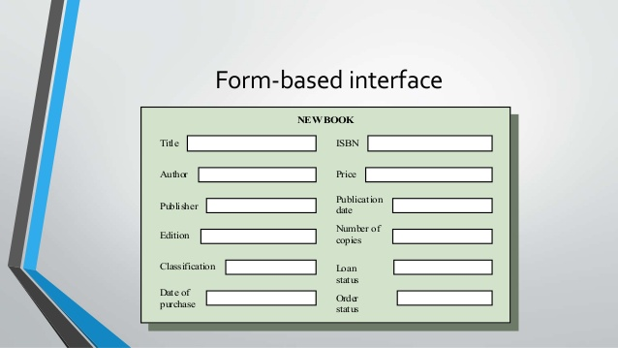

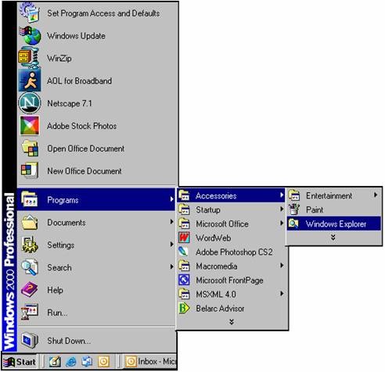


Slide 58
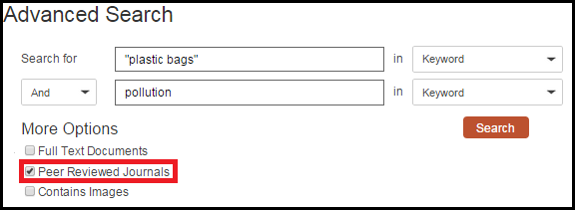
Keyword based database search

Slide 59
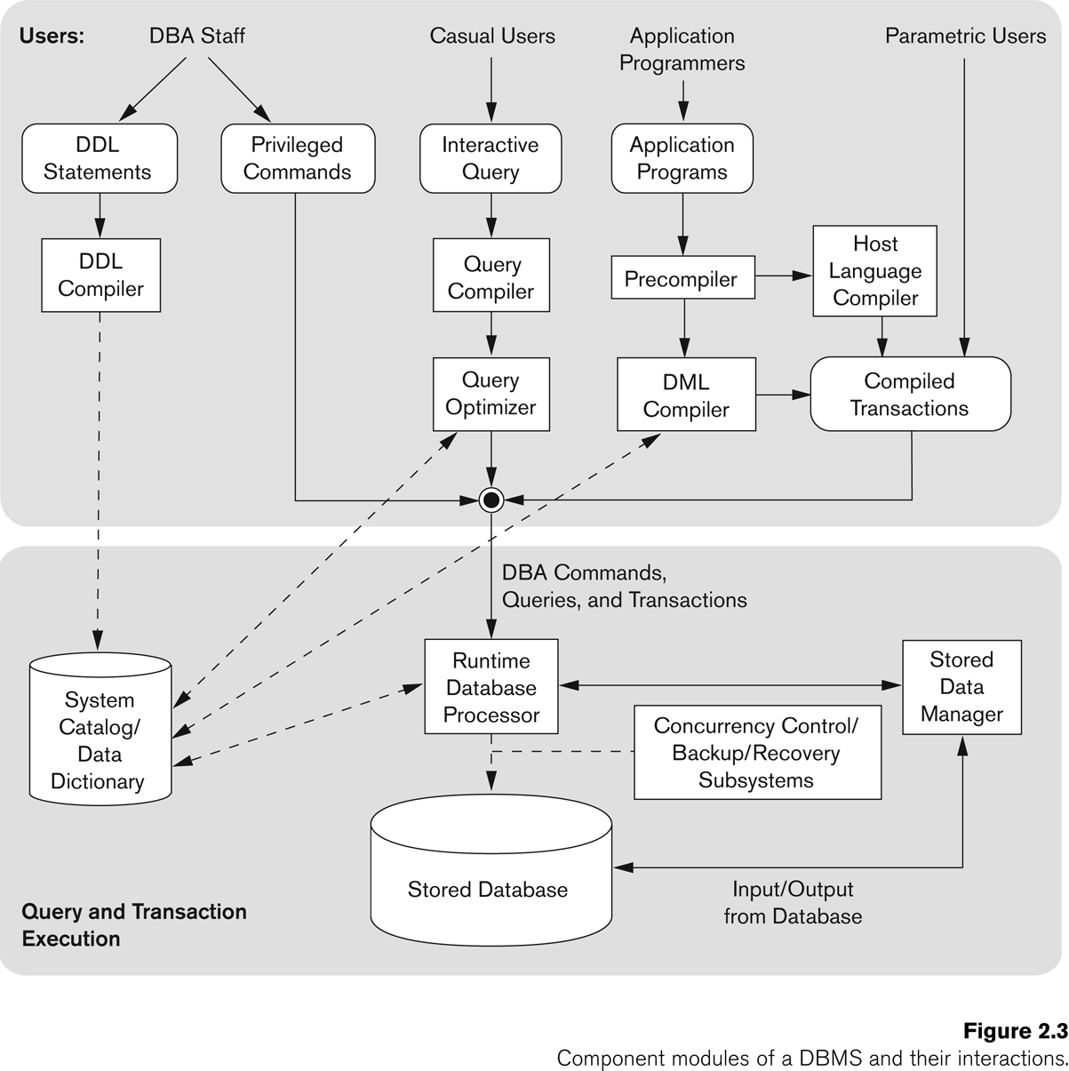
The Database System Environment

Slide 60
Database System Utilities
To perform certain functions such as:
  Loading data stored in files into a database. Includes data conversion tools.
  Backing up the database periodically on tape.
  Reorganizing database file structures.
  Report generation utilities.
  Performance monitoring utilities.
  Other functions, such as sorting, user monitoring, data compression, etc.

Slide 61
Other Tools
Data dictionary / repository:
  Used to store schema descriptions and other information such as design decisions, application program descriptions, user information, usage standards, etc.
  Active data dictionary is accessed by DBMS software and users/DBA.
  Passive data dictionary is accessed by users/DBA only.

Slide 62
Other Tools
Application Development Environments and CASE (computer-aided software engineering) tools:
Examples:
  PowerBuilder (Sybase)
  JBuilder (Borland)
  JDeveloper 10G (Oracle)

Slide 63
CHAPTER 3
Entity Types, Entity Sets, Attributes, Keys, Roles, Constraints, ER-Diagrams

Slide 64
Entities and Attributes
Entity: Real-world object distinguishable from other objects. An entity is described (in DB) using a set of attributes.
  Physical existence
  Conceptual existence
  Attribute: the particular properties that describes entity

Slide 65
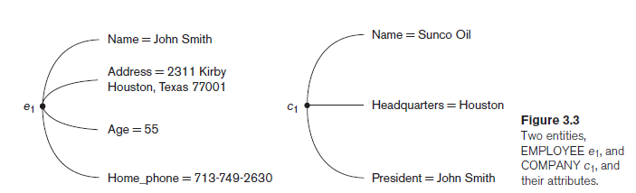

Slide 66
Types of attributes
Simple/Atomic
Composite
Single valued
Multivalued
Stored
Derived

Slide 67
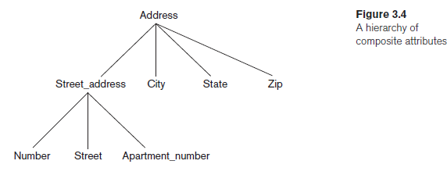
Types of Attributes (continued)
Composite vs simple attributes: Composite can be divided into smaller subparts (basic attributes-independent meaning)
Attributes that are not divisible are simple or atomic attributes

Slide 68
Types of Attributes (continued)
Single valued vs multivalued: Attributes that have single value for a particular entity are single valued.
  Ex: Age of a person
Attributes that have two or more values are multivalued.
  Lower and upper bounds
  Ex: Degree of a person

Slide 69
Types of Attributes (continued)
Stored vs derived attributes: Two or more attribute values are related.
  Ex: Age and DOB of a person
  Age can be determined by current date and DOB
  Derived: Age
  Stored: DOB
    NULL: Attribute that doesn’t have any value
      Not applicable - Ex: College degree attribute, Apartment number
      Unknown – missing & not known – Ex: Home phone

Slide 70

Types of Attributes (continued)
  Complex Attributes: Grouping of composite attributes ( ) and separating components with commas, and displaying multivalued attributes { }.
    Ex: Person with more than one residence – single address – multiple phones
    - Phone and Address are composite
    - Address_phone is complex

Slide 71
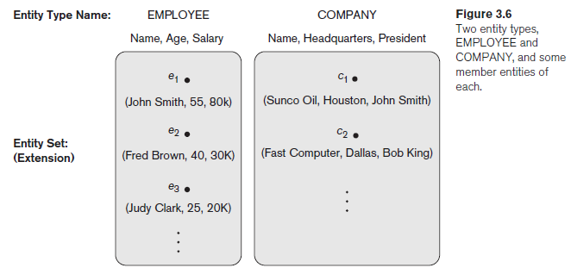
Entity Types
Entity type: Collection of entities that have same attributes.
Each entity type is described by its name and attributes.

Slide 72
Entity Sets
Entity Set / Entity collection: Collection of all entities of a particular entity type in the database at any point of time.
Key: is a minimal set of attributes of an entity set, which would uniquely identify an entity in an entity set. It can be a single attribute or more than one attribute (composite key), but it should be minimal set.

Slide 73
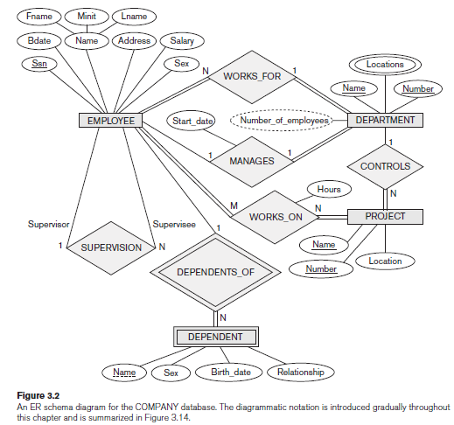

Slide 74
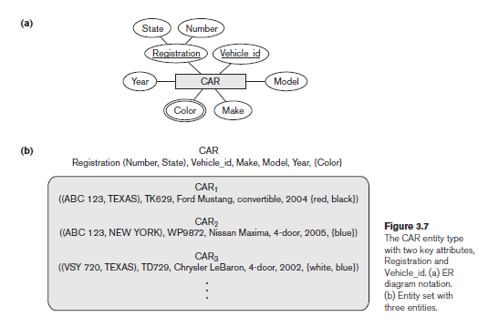
Key attributes of an entity type: one or more attributes whose values are distinct for each individual entity in the entity set
  Underlined in ER diagram

Slide 75
Value sets (Domains) of attributes: set of values that may be assigned to an attribute for each individual entity.
  Ex: Age: domain is [18-58]
  Name: domain is [A-Z], [a-z] and a blank space
  Mathematical representation
  An attribute A of entity set E whose value set is V can be defined as a function from E to the power set P(V) of V:
    A : E → P(V)

Slide 76
Initial Conceptual Design
First step: ER diagram – identify all the entity sets
Second step: include all necessary attributes for each entity set
Third step: pick an attribute which would act as a key
Example: Company Database

Slide 77
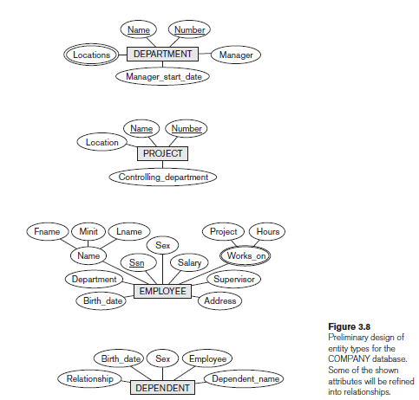

Slide 78
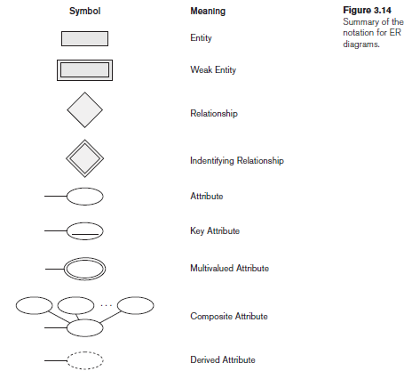
ER Diagram Notations

Slide 79
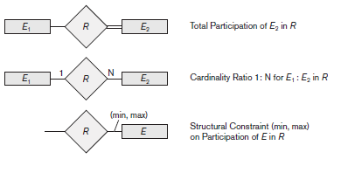
ER Diagram Notations

Slide 80
Relationship types
Relationship: An association among two or more entities
Relationship type: R among n entity sets E1, E2,… En defines a set of associations among entities from these entity types (Relationship set)
Relationship instances: rp where each ri associates n individual entities(e1,e2,..en) and each entity ej in ri is a member of entity set Ej, 1<=j<=n

Slide 81
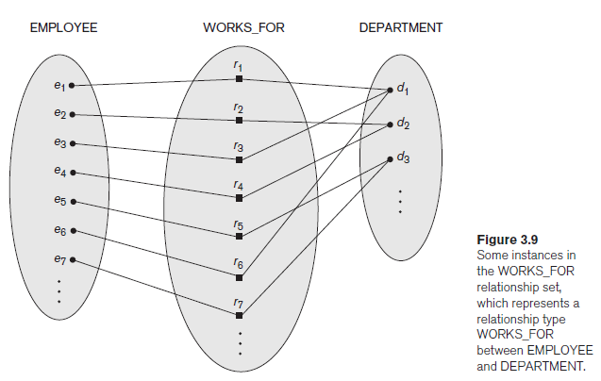

Slide 82
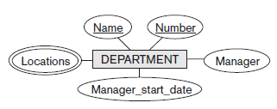
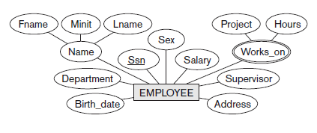
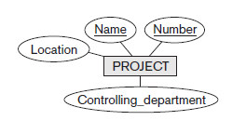
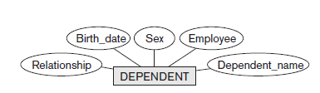
Initial conceptual design of the COMPANY database

Slide 83
Relationship Types, Sets and Instances
A relationship type R among n entity types E1, E2,...,En defines a set of associations or a relationship set among entities from these entity types
Mathematically, the relationship set R is a set of relationship instances ri, where each ri associates n individual entities (e1, e2, . . . , en), and each entity ej in ri is a member of entity set Ej, 1 ≤ j ≤ n
Informally, each relationship instance ri in R is an association of entities, where the association includes exactly one entity from each participating entity type.

Slide 84
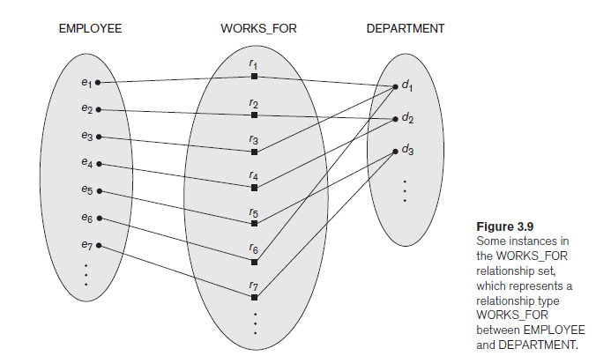

Slide 85
Relationship Degree, Role Names, and Recursive Relationships
The degree of a relationship type is the number of participating entity types
A relationship type of degree two is called binary, and one of degree three is called ternary

Slide 86
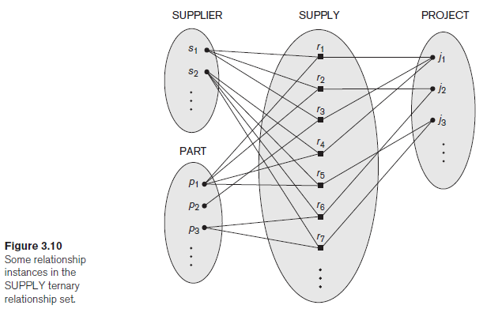

Slide 87
Role Names and Recursive Relationships
The role name signifies the role that a participating entity from the entity type plays in each relationship instance, and it helps to explain what the relationship means
  For example, in the WORKS_FOR relationship type, EMPLOYEE plays the role of employee or worker and DEPARTMENT plays the role of department or employer.
The same entity type participates more than once in a relationship type in different roles.
In such cases the role name becomes essential for distinguishing the meaning of the role that each participating entity plays. Such relationship types are called recursive relationships or self-referencing relationships

Slide 88
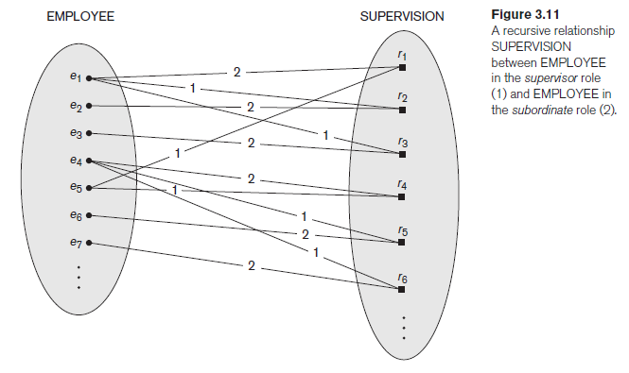

Slide 89
Relationships as Attributes
It is sometimes convenient to think of a binary relationship type in terms of attributes
  Department of the EMPLOYEE entity type, where the value of Department for each EMPLOYEE entity is (a reference to) the DEPARTMENT entity for which that employee works

Slide 90
Constraints on Binary Relationship Types
Relationship types usually have certain constraints that limit the possible combinations of entities that may participate in the corresponding relationship set
Two main types of binary relationship constraints: cardinality ratio and participation.
The cardinality ratio for a binary relationship specifies the maximum number of relationship instances that an entity can participate in. For example, in the WORKS_FOR binary relationship type, DEPARTMENT:EMPLOYEE is of cardinality ratio 1:N

Slide 91
The possible cardinality ratios for binary relationship types are 1:1, 1:N, N:1, and M:N
Cardinality ratios for binary relationships are represented on ER diagrams by displaying 1, M, and N on the diamond symbol

Slide 92
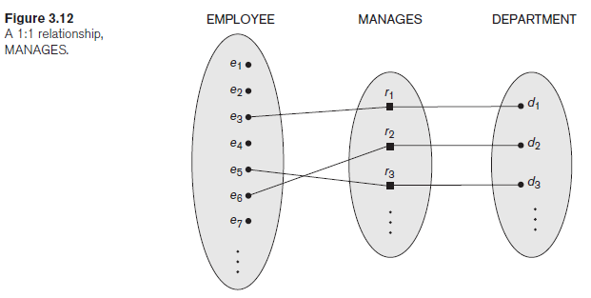
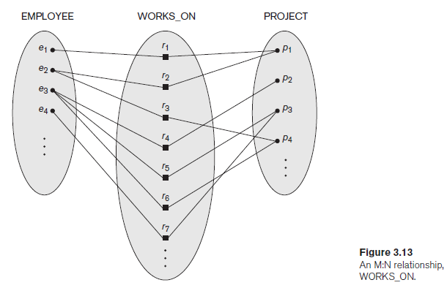

Slide 93
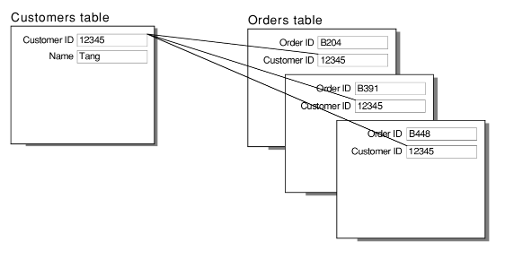
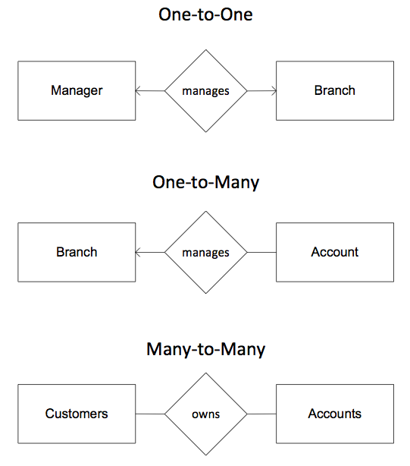
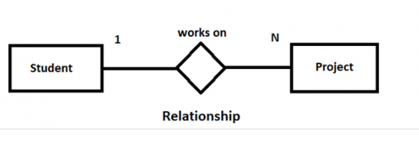
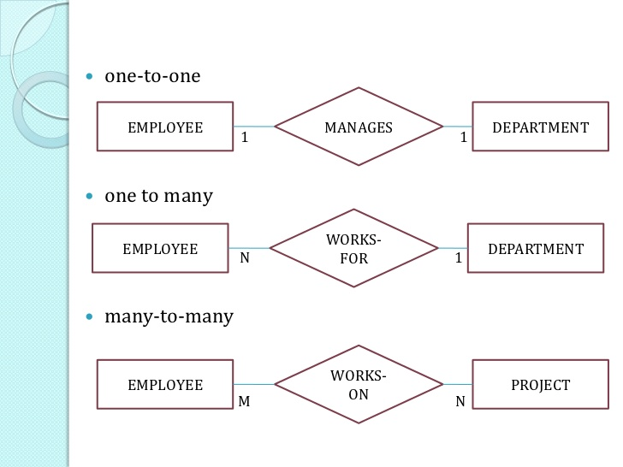

Slide 94
Participation Constraints and Existence Dependencies
The participation constraint specifies whether the existence of an entity depends on another entity via the relationship type.
This constraint specifies the minimum number of relationship instances that each entity can participate in and is sometimes called the minimum cardinality constraint
  There are two types of participation constraints— total (existence dependency)and partial

Slide 95
  Total Participation/ Existence dependency
  The participation of EMPLOYEE in WORKS_FOR is called total participation, meaning that every entity in the total set of employee entities must be related to a department entity via WORKS_FOR
  Partial Participation
  We do not expect every employee to manage a department, so the participation of EMPLOYEE in the MANAGES relationship type is partial, meaning that some or part of the set of employee entities are related to some department entity via MANAGES, but not necessarily all
The cardinality ratio and participation constraints, together called as the structural constraints

Slide 96
Attributes of relationship types
Relationship types can also have attributes, similar to those of entity types.
  For example, to record the number of hours per week that a particular employee works on a particular project, we can include an attribute Hours for the WORKS_ON relationship type
  Date on which a manager started managing a department via an attribute Start_date for the MANAGES relationship type

Slide 97
Notice that attributes of 1:1 relationship types can be migrated to one of the participating entity types
  For example, the Start_date attribute for the MANAGES relationship can be an attribute of either EMPLOYEE (manager) or DEPARTMENT, although conceptually it belongs to MANAGES
  For a 1:N relationship type, a relationship attribute can be migrated only to the entity type on the N-side of the relationship
  For example, if the WORKS_FOR relationship has an attribute Start_date that indicates when an employee started working for a department, this attribute can be included as an attribute of EMPLOYEE

Slide 98
Weak Entity Type
Entity types that do not have key attributes of their own are called weak entity types
Regular entity types that do have a key attribute are called strong entity types
Identifying or owner entity type
Identifying relationship
A weak entity type always has a total participation constraint
  Ex: DEPENDENT, related to EMPLOYEE. Two dependents of two distinct employees may have the same values for Name, Birth_date, Sex, and Relationship, but they are still distinct entities. They are identified as distinct entities only after determining the particular employee entity to which each dependent is related

Slide 99
Weak Entity Type Cont..
Partial key, which is the attribute that can uniquely identify weak entities that are related to the same owner entity
The partial key attribute is underlined with a dashed or dotted line
  Ex: Name of DEPENDENT
  Weak entity types can sometimes be represented as complex attributes
  In the preceding example, we could specify a multivalued attribute Dependents for EMPLOYEE, which is a multivalued composite attribute with the component attributes Name, Birth_date, Sex, and Relationship

Slide 100
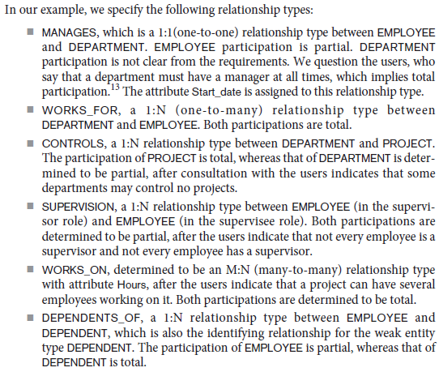
Refining ER design of Company Database

Slide 101
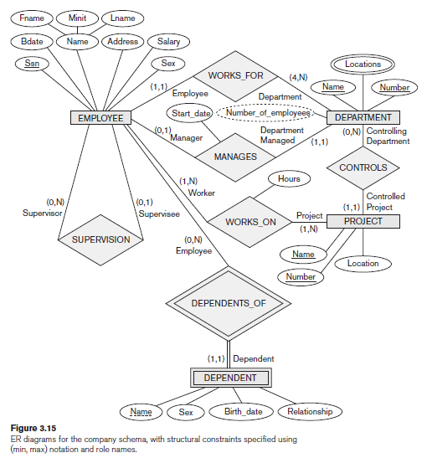
Alternative notations for ER Diagrams

Slide 102
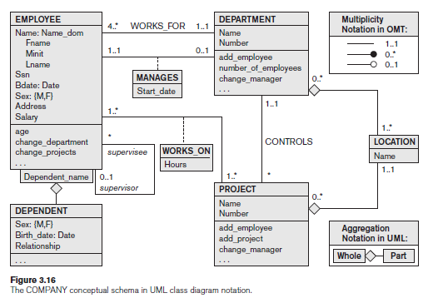

Slide 103
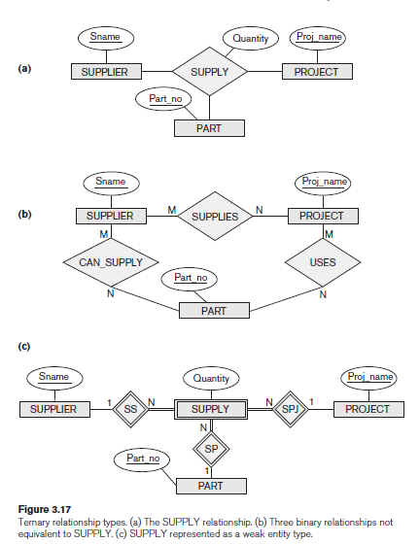

Slide 104
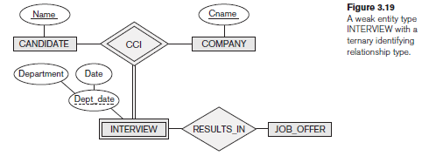

Slide 105
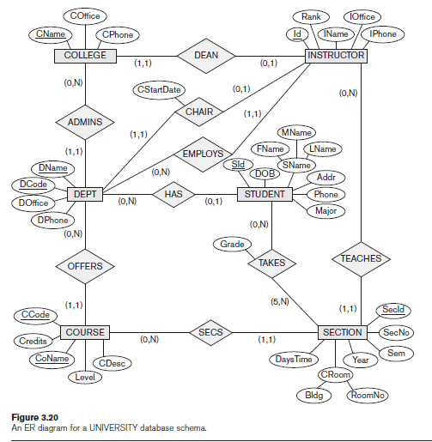
University Database

Slide 106
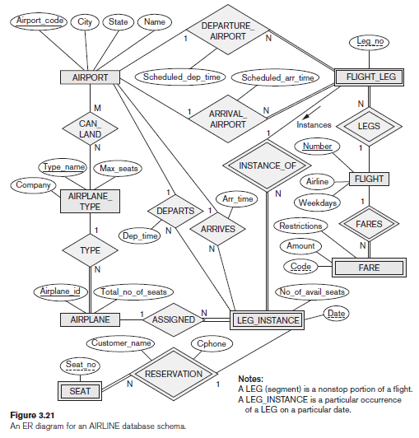
Airline Database

Slide 107
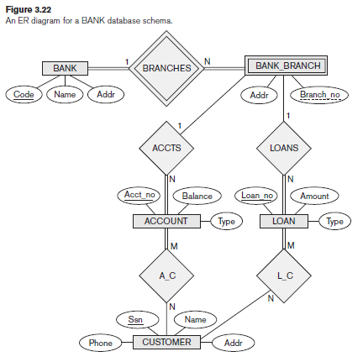
Bank Database

Slide 108
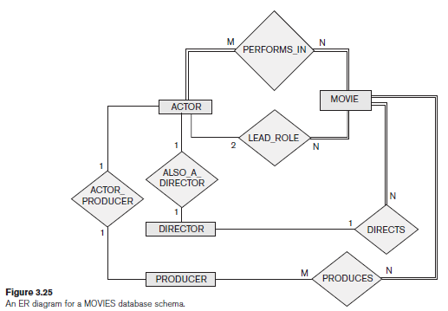
Movie Database

Slide 109
CHAPTER 4
The Enhanced Entity Relationship (EER) Model

Slide 110
Specialization and Generalization
In many cases an entity type has numerous subgroupings or subtypes of its entities that are meaningful and need to be represented explicitly because of their significance to the database application.
  For example, the entities that are members of the EMPLOYEE entity type may be distinguished further into SECRETARY, ENGINEER, MANAGER, TECHNICIAN, SALARIED_EMPLOYEE, HOURLY_EMPLOYEE, and so on
  EMPLOYEE entity type is called the superclass or supertype for each of these subclasses
  An entity that is a member of a subclass inherits all the attributes of the entity as a member of the superclass.

Slide 111
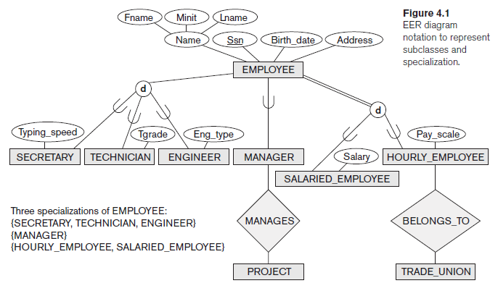

Slide 112
Specialization
Specialization is the process of defining a set of subclasses of an entity type; this entity type is called the superclass of the specialization
The set of subclasses that forms a specialization is defined on the basis of some distinguishing characteristic of the entities in the superclass.
  For example, the set of subclasses {SECRETARY, ENGINEER, TECHNICIAN} is a specialization of the superclass EMPLOYEE that distinguishes among employee entities based on the job type of each employee

Slide 113
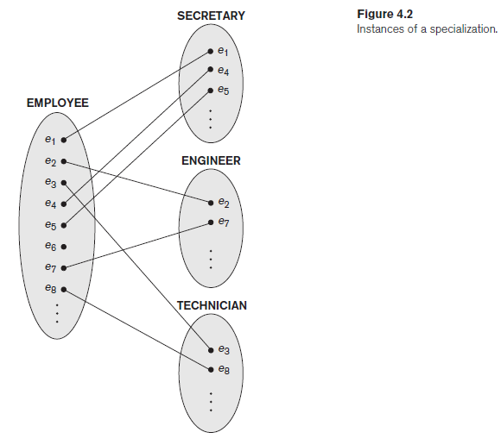

Slide 114
There are two main reasons for including class/subclass relationships and specializations.
The first is that certain attributes may apply to some but not all entities of the superclass entity type
The second reason for using subclasses is that some relationship types may be participated in only by entities that are members of the subclass.

Slide 115
Generalization
The term generalization is used to refer to the process of defining a generalized entity type from the given entity types
It is functionally the inverse of the specialization process
Reverse process of abstraction-suppress the differences among several entity types, identify their common features, and generalize them into a single superclass of which the original entity types are special subclasses

Slide 116
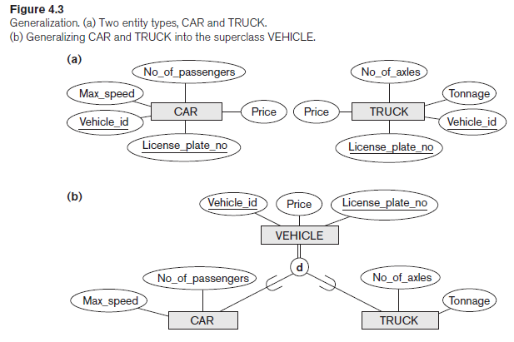

Slide 117
An arrow pointing to the generalized superclass represents a generalization process
The arrows pointing to the specialized subclasses represent a specialization process

